Slide 1
PROGRAM
LEARN TO
SCRA
FRC Vision Options
AT SHARP
Lucas Switzer #3260
12-13-12

Slide 2
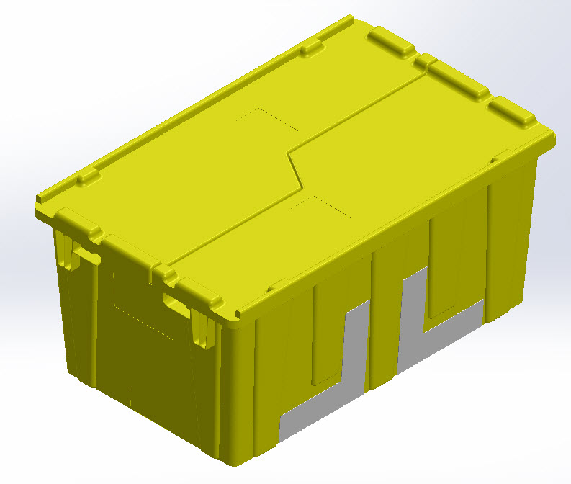
Why do we need vision?

Slide 3
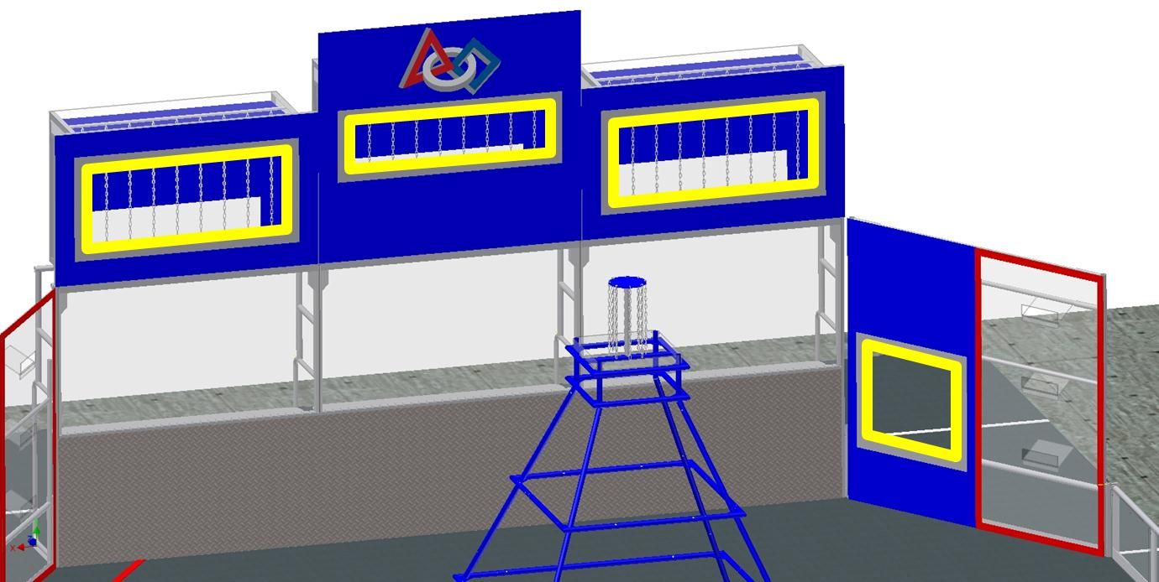
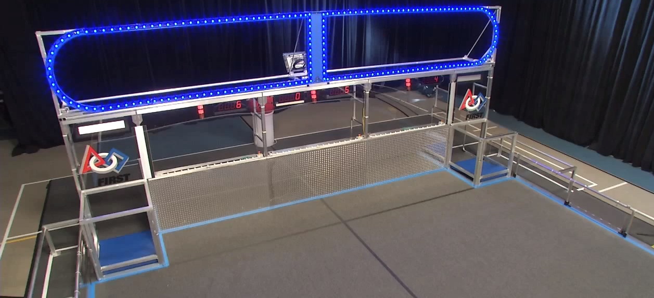
Ultimate Ascent : Goal Alignment
Aerial Assist : Hot Goal Detection

Slide 4


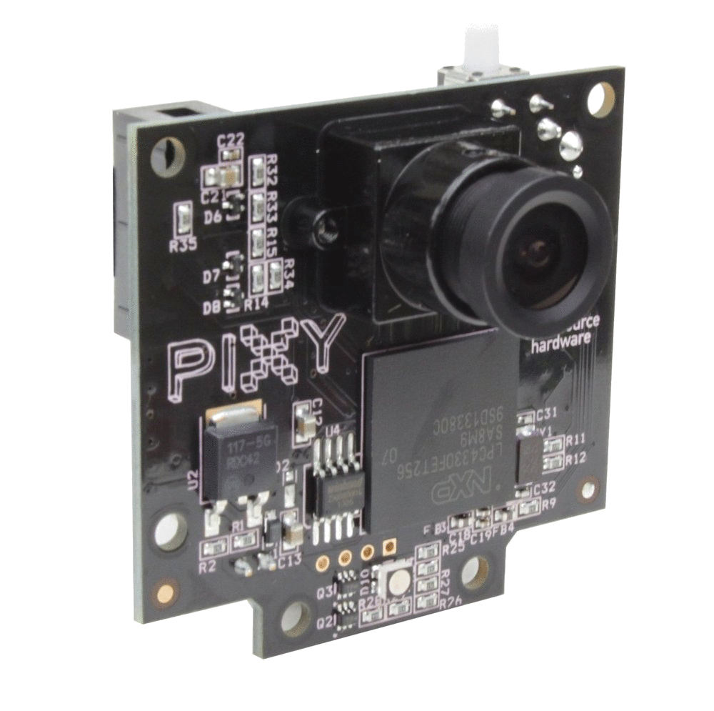

Robo Realm
NI Vision
CMUcam5 Pixy
OpenCV

Slide 5
Robo Realm

Slide 6

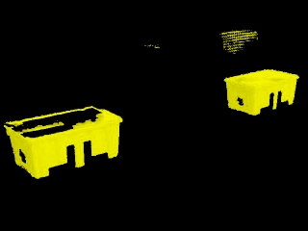
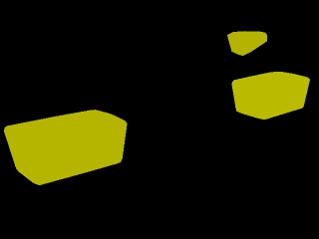
Pros
Cons
Simple ◊
◊ No Flexibility
Color Detection |
Minimal Programming ◊
◊ Windows Only
Full FRC Support ◊
◊ DS Processing
No Language Restrictions ◊
◊ Visual Basic Macros
Edge Detection and Mat |

Slide 7
NI Vision

Slide 8
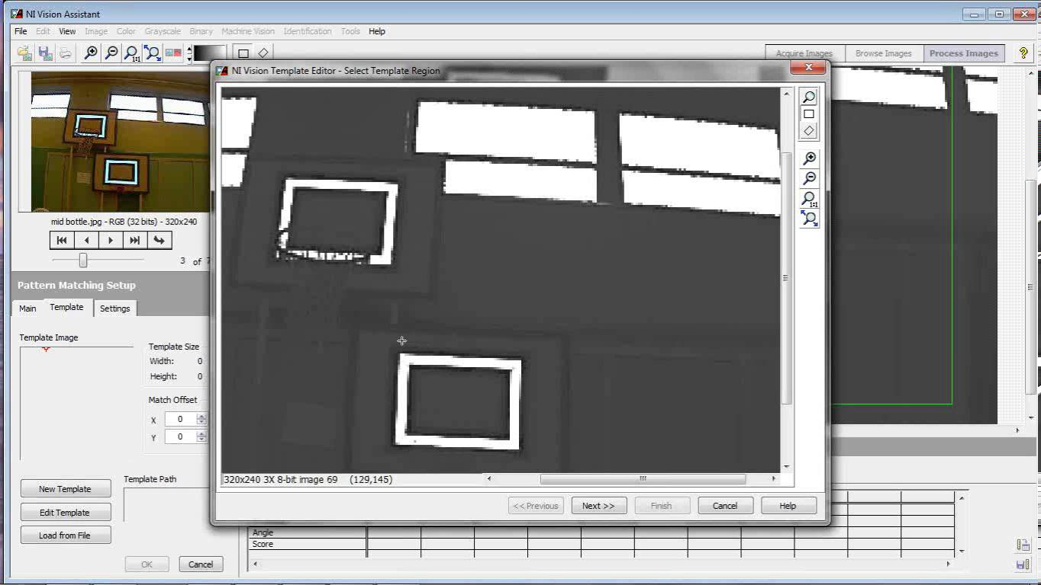
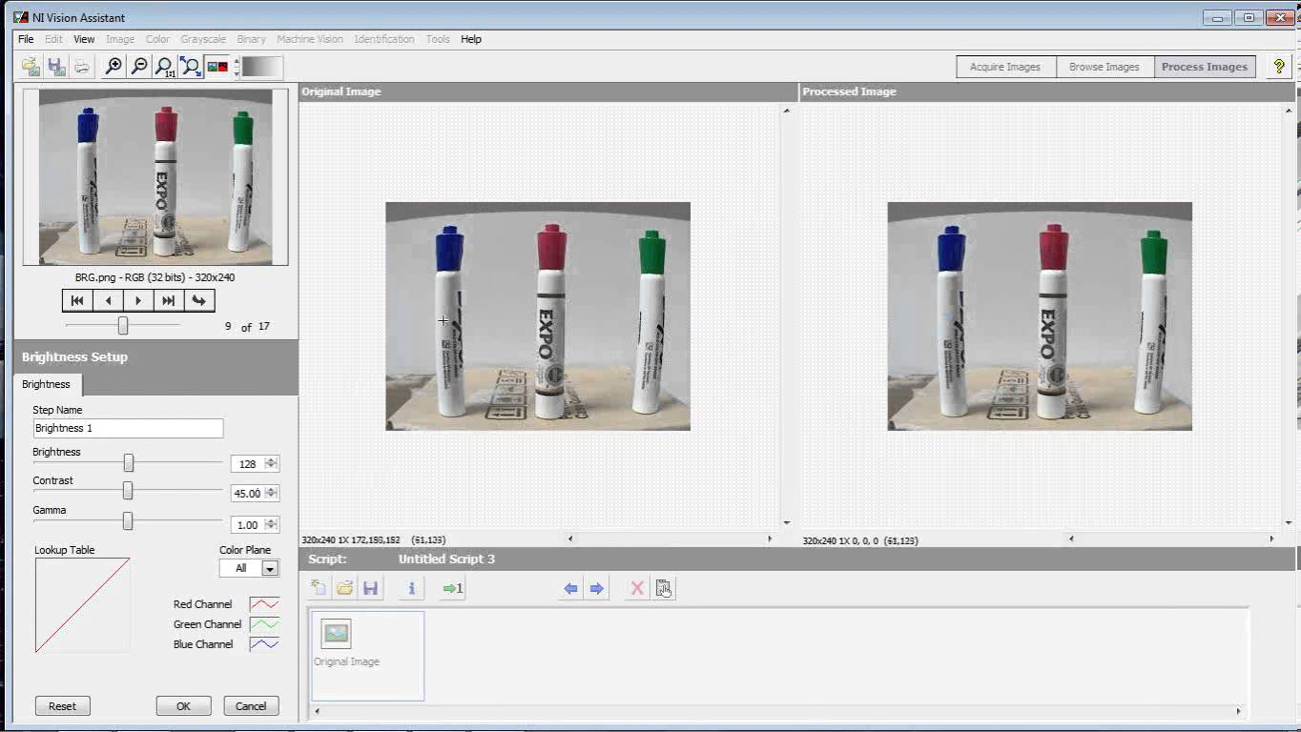
Pros
Cons
Makes LabVIEW Vision Easy ◊
◊ LabVIEW Only
Goal Detection |
Scripting VI Generator ◊
◊ Relies on Axis Camera
Full FRC Support ◊
Vision Assistant |

Slide 9
CMUcam5 Pixy

Slide 10
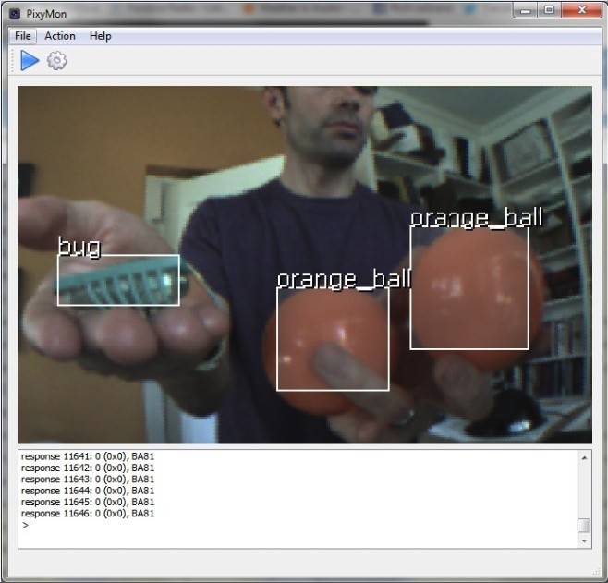
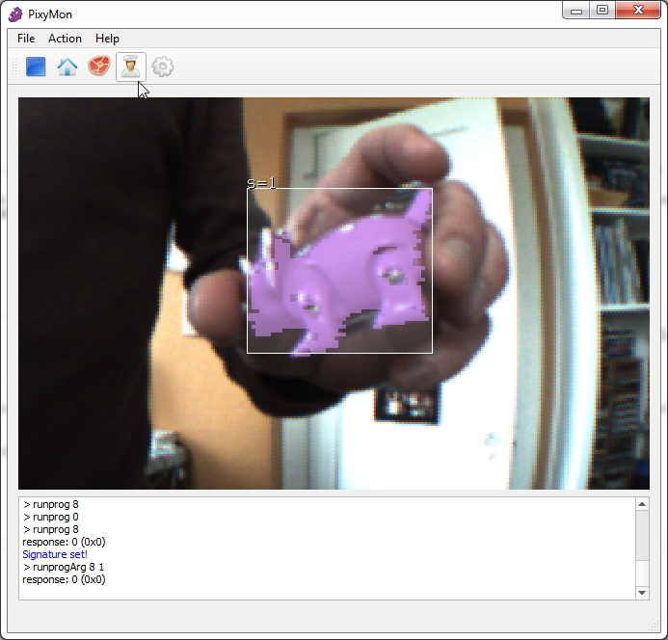
CMU Pixy
Pros
Cons
On Board Vision ◊
◊ No FRC Support
Multiple Object Detection |
“Plug and Play” ◊
◊ $70
Local Communication ◊
◊ Reliability
Multiple Object Detection ◊
◊ Calibration!
“Object Teaching” ◊
Object Teaching |

Slide 11
OpenCV

Slide 12
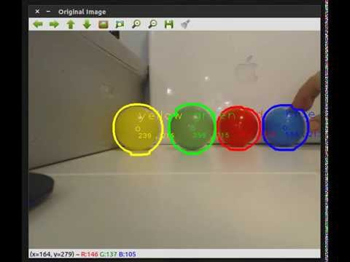
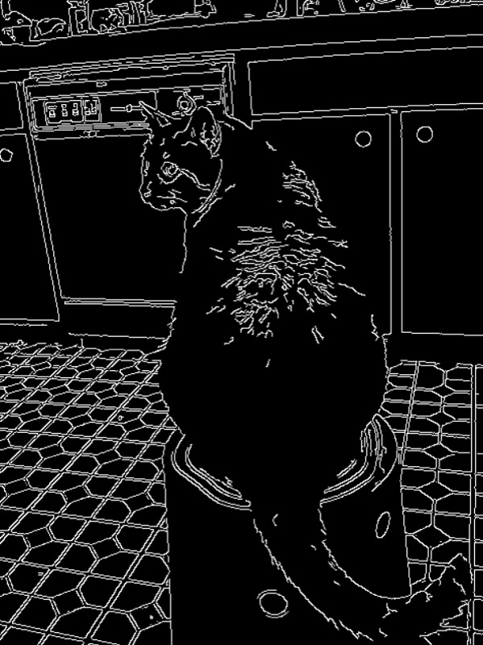
Pros
Cons
Freedom! ◊
◊ Some FRC Support
Multiple Object Color Detection |
Java, C++, Python ◊
◊ Requires extra hardware
Camera Manipulation ◊
◊ $$$
◊ Complicated
Object Teaching |

Slide 13
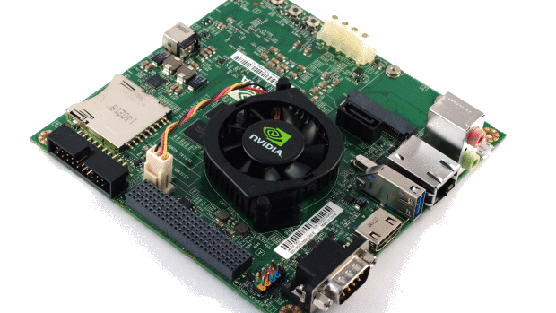
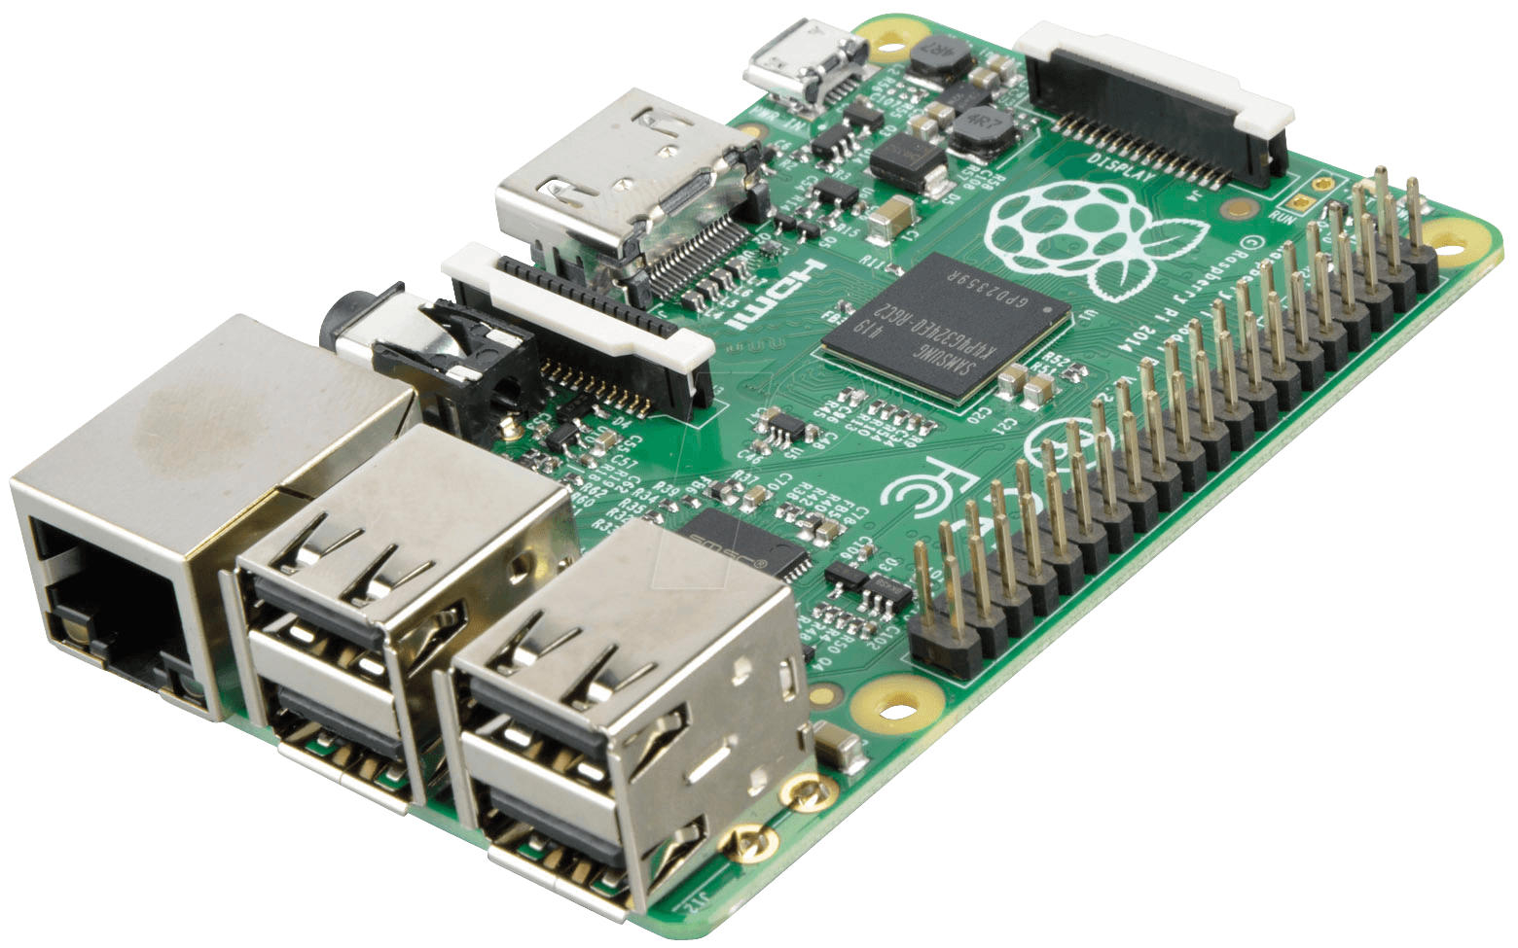
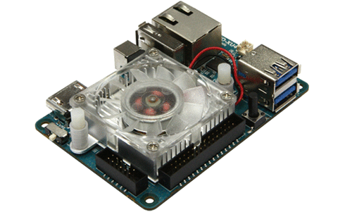
Supported Hardware
Raspberry Pi B+
ODROID-XU4
NVIDIA JetsonTK1
$40
$80
$200
or FIRST Choice

Slide 14

Team 3260:
https://github.com/SarahHeinzHouseFRC/SCRA-2015-Workshops
My Personal:
https://github.com/SarahHeinzHouseFRC/SCRA-2015-Workshops

